Slide 1

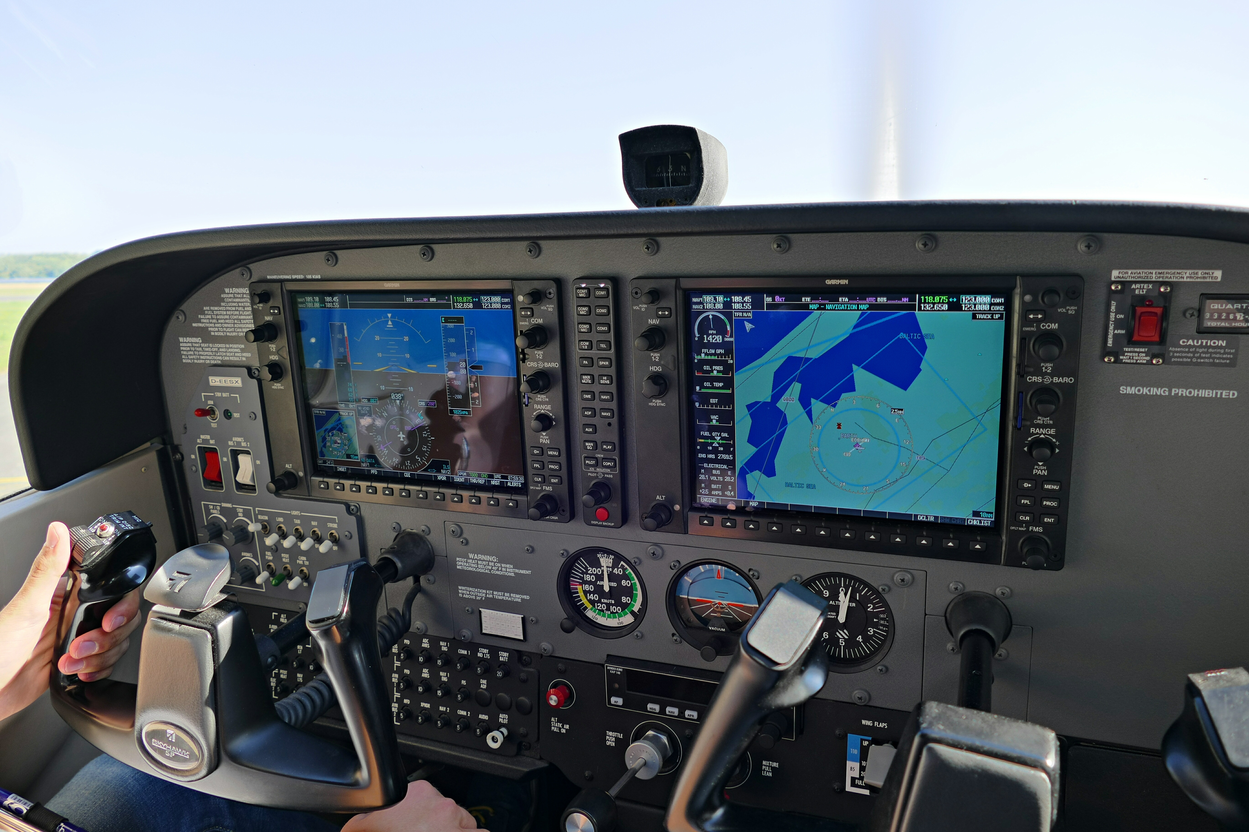


Proposal for a Modernized Flight Risk Assessment Tool for General Aviation Pre-Flight Planning
Category: Improve Aviation Safety
Hunter Walden
Kathleen Hill
Chi Quinn
Erick Torres
Dr. Isaac Gang, Project Advisor
Notes:
Hunter Intro

Slide 2





Our Team
Hunter Walden
Data Engineer
Steampunk, Inc.
Former USMC MV-22 Pilot
M.S. Data Analytics Engineering, Student George Mason University
Kathleen Hill
Data Scientist
Systems Planning and Analysis, Inc.
M.S. Data Analytics Engineering, George Mason University
Chi Quinn
Business Intelligence Analyst
American Society for Radiation Oncology
M.S. Data Analytics Engineering, Student George Mason University
Erick Torres
Data Scientist
Serco-NA
M.S. Data Analytics Engineering, George Mason University
Dr. Isaac Gang
Project Advisor
Associate Professor
College of Engineering and Computing
MS Data Analytics Program
George Mason University

Slide 3



Problem Statement
Pre-flight risk assessment is a key step in the pre-flight planning process to ensure the safety of flight prior to takeoff. Traditional flight risk assessment tools (FRATs) are often inaccessible, time-intensive, and incomplete. This can lead to improper or time-critical risk assessment in flight, rather than complete and deliberate risk mitigation.
The solution is to augment traditional FRATs with automated risk assessment based on pilot and flight profiles to produce a risk score that the pilot can then further evaluate for potential risk mitigation. This speeds up the risk assessment process, potentially reduces pilot bias, and can be incorporated into pre-flight planning applications.
Problem Solution

Slide 4
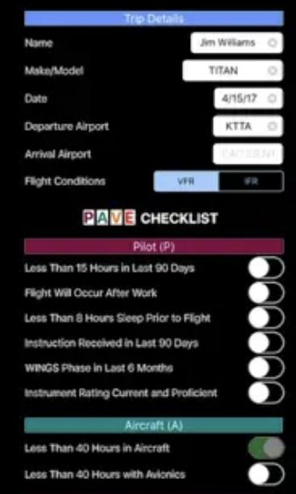
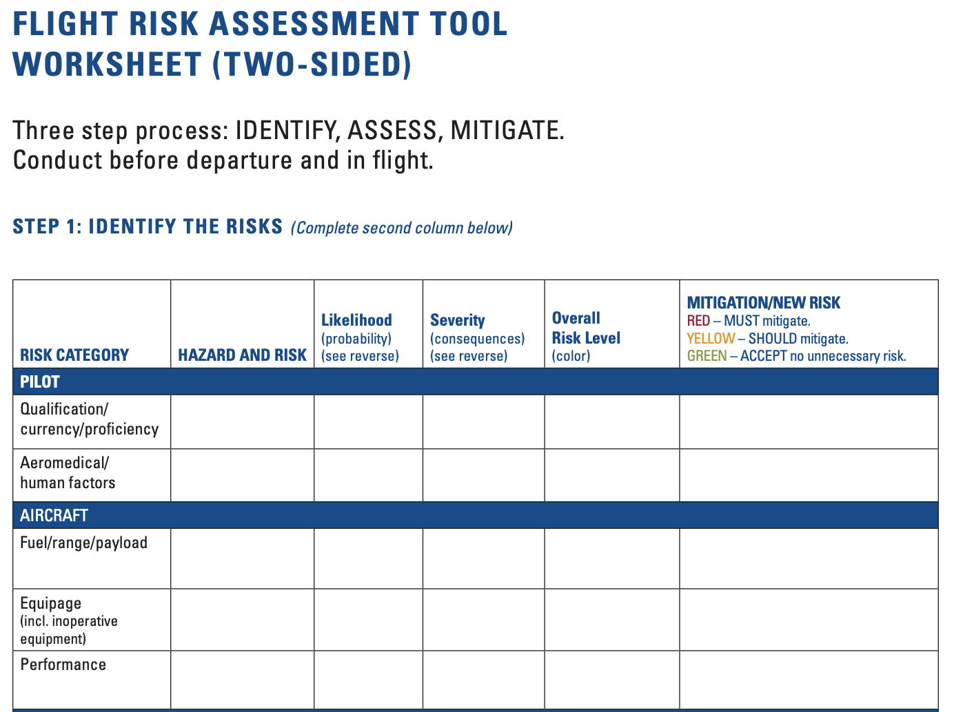
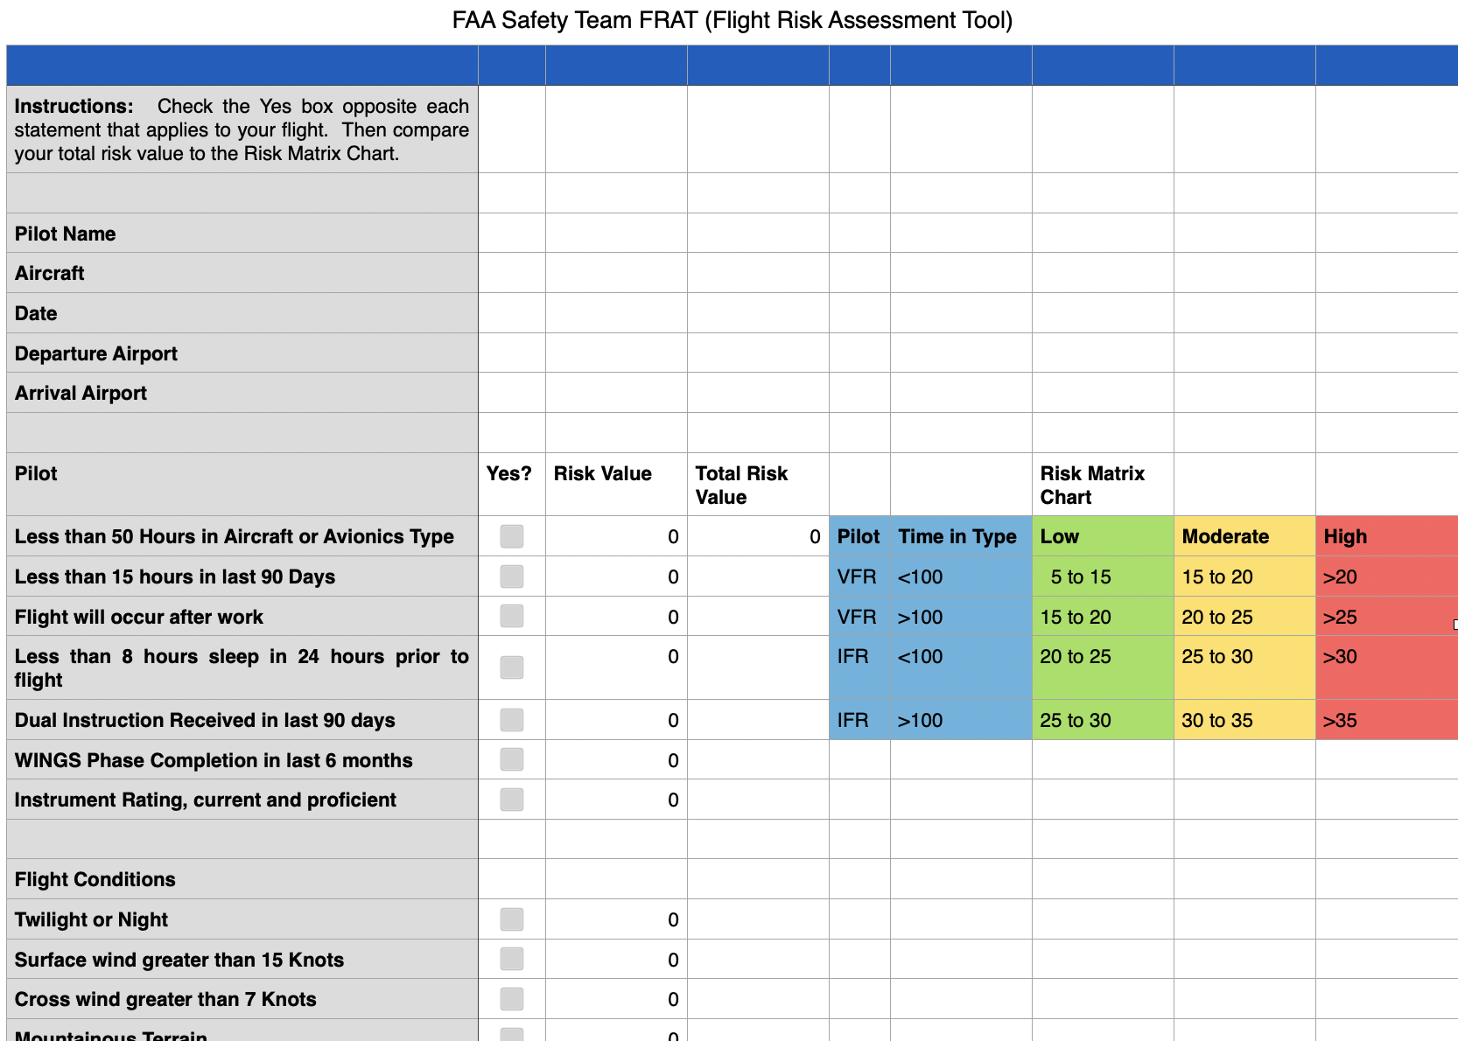
Available Flight Risk Assessment Tools (FRAT)
Though there are FRATs on the market, most include a score-based system based on pilot input which might be prone to bias.
Background
“Poor risk management was a root cause of nearly 50 percent of the fatal business aircraft accidents.”
– Wright, 2019
“Civilian aviation operations excluding paid passenger transport, accounts for 94% of civilian aviation fatalities.” – Boyd, 2017
“60% of fatal accidents occurred while flying in instrument meteorological conditions (IMC), most frequently “between October and April, on weekends, in early morning and evening periods, and along the West Coast, Colorado Rockies, Appalachian Mountains, and the Northeast.”
– Fultz & Ashley, 2016
ZDigitalPro, LLC FRAT App
National Business Aviation Association
FAA Safety Team FRAT
Notes:
Hunter
Kathleen- to add versions of current FRAT tools

Slide 5
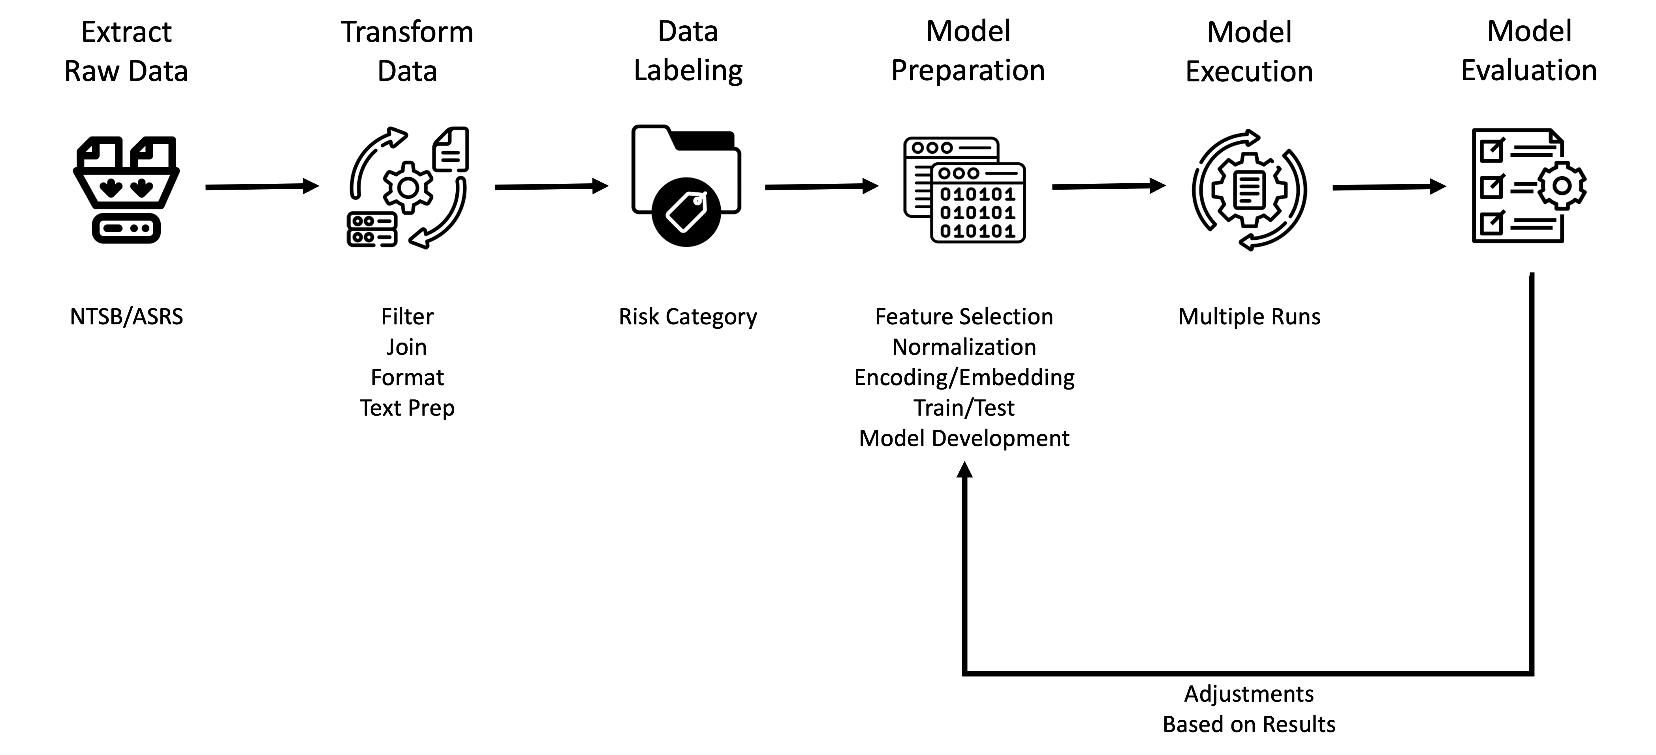
Methodology
FRAT Project Modeling Methodology

Slide 6


Number
of Records:
46,052
Data
Years:
1983-2022
Total Flight Hours
Actual Instrument Time
Flight Hours in Make
Flight Hours at Night
Rotary Wing Flight Hours
Single Engine Flight Hours
Multi-Engine Flight Hours
Simulated Instrument Hours
Dept/Dest Airport
Airport Location
Airport Elevation
Departure Time
Runway length
Runway width
Day of week
Month
Feature Selection
Pilot
Aircraft
Environment
Weather
Aircraft Make
Aircraft Model
Airframe Hours
Certified Max Gross Weight
Airframe Inspection Timeline
Engine hours
No. Engines
Engine Manufacturer
Temperature / Dewpoint
Wind Direction / Speed
Meteorological conditions
Ceilings
Visibility
Weather Observation Time
Light Conditions
Wind Gust Speed

Slide 7
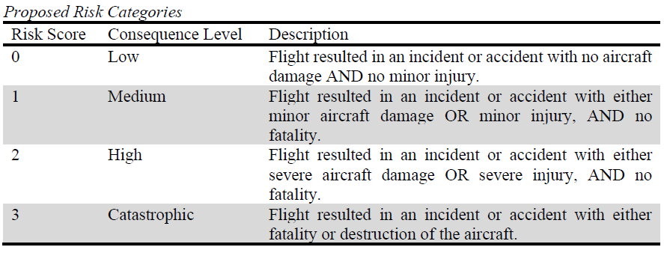
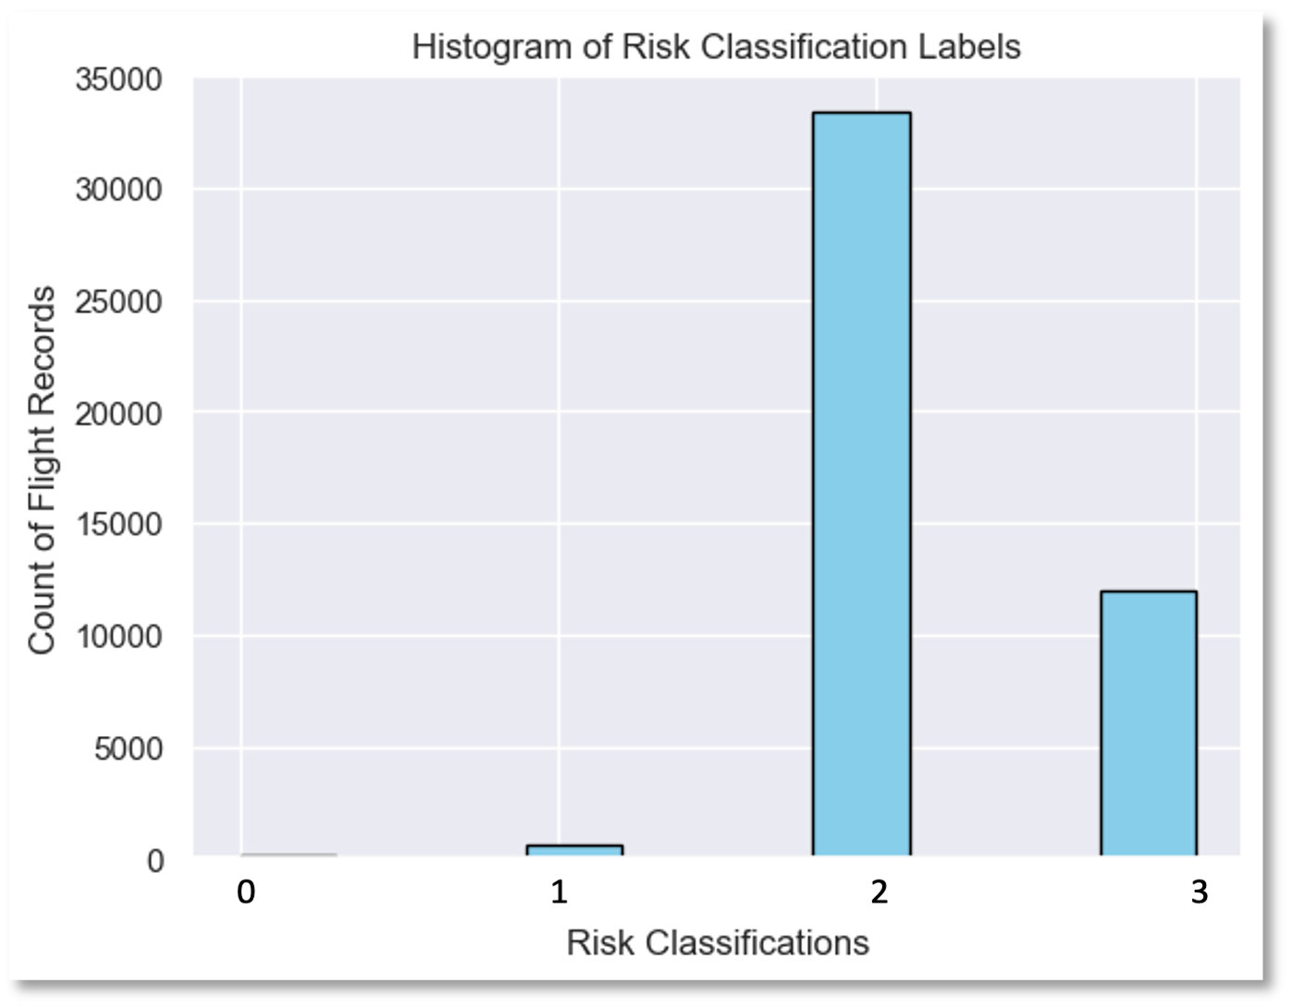
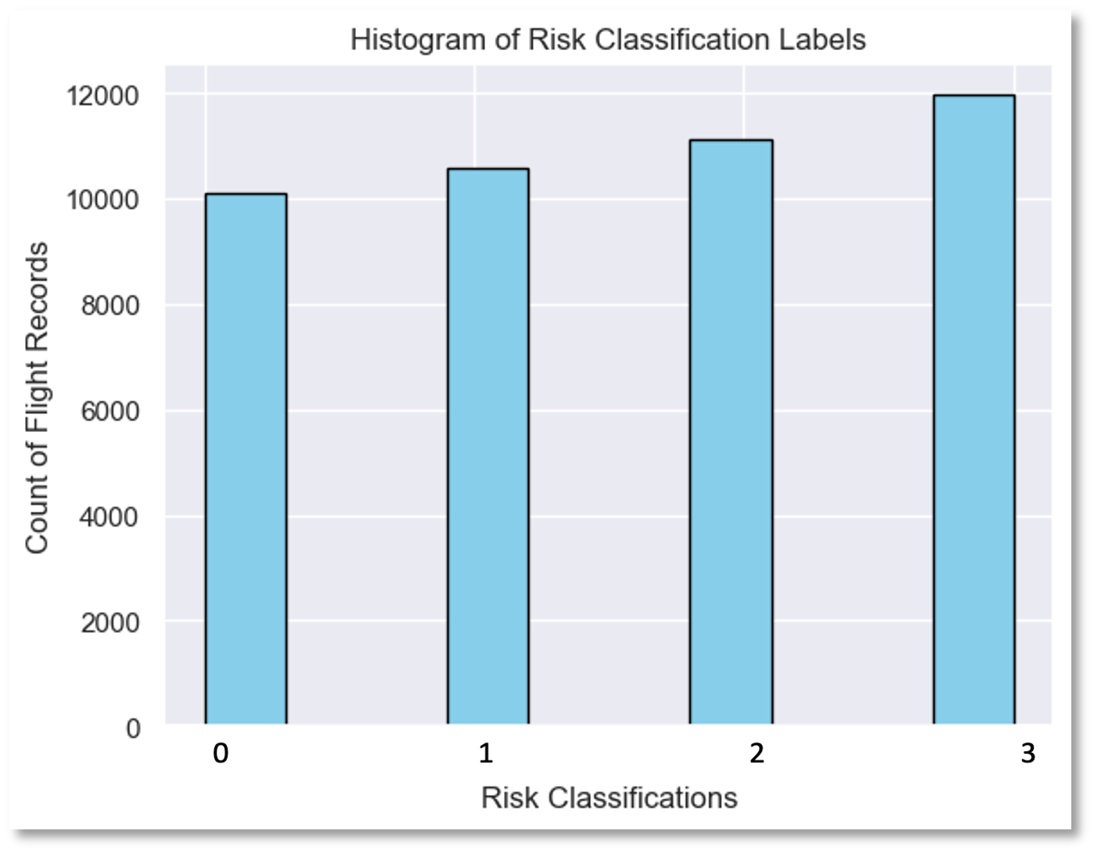
Cleaning the Dataset
Data Transformation
Fixing random errors, binning, and formatting
Labeling the Dataset: Risk Categories
Proposed Risk Categories
Note: When comparing aircraft damage and injury, the highest of the two dictates the classification. Numerical risk scores are only utilized for modeling purposes, and it is preferred that an end user see an output of “Low” or “High” rather than 0 or 2. The risk score of 0 does not imply a no-risk flight.
Standardizing Datatypes
Balancing the Dataset: Resampling
Risk Classification Labels before resampling
Risk Classification Labels after resampling
Label Encoding
Handling
Missing
Data
Notes:
To Discuss:
Cleanliness of the dataset, Risk Categories, imbalanced dataset following labeling, NaN imputation (Add some notes from NN trouble)

Slide 8

Modeling
XGBoost
Random Forest
Feed-Forward Neural Network
BERT
Notes:
Chi

Slide 9
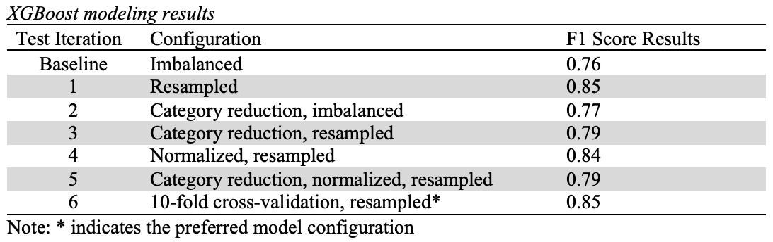
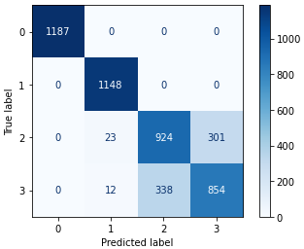
Process
Modeling
XGBoost
XGBoost Modeling Results
Dataset Balancing
Model Configuration
Preferred Model Configuration Confusion Matrix
Results
Overall, class 0 and 1 seemed overfit due to resampling techniques, but it improved the ability to more accurately predict class 2 and 3.
Label
Effects
10-Fold
Cross Validation
Notes:
Training process:
Imbalanced vs. balanced dataset
Resampling benefits
Multiple configurations
Label effects
10-fold cross validation to check for overfitting

Slide 10
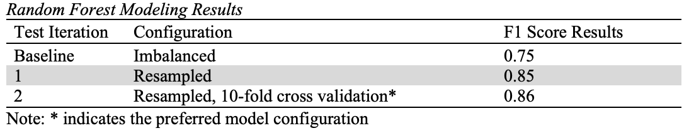
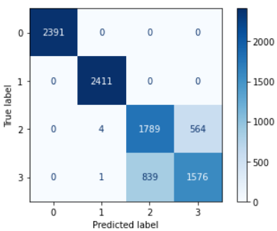
Process
Modeling
Random Forest
Dataset Balancing
Random Forest Modeling Results
Model Configuration
Preferred Model Configuration Confusion Matrix
Results
10-fold cross validation returned the highest F1 score – 0.86
Model correctly predicted highest risk classifications
10-Fold
Cross Validation

Slide 11
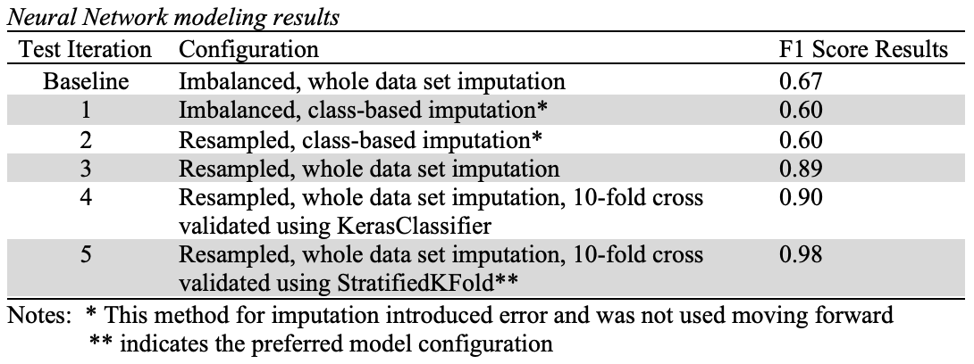
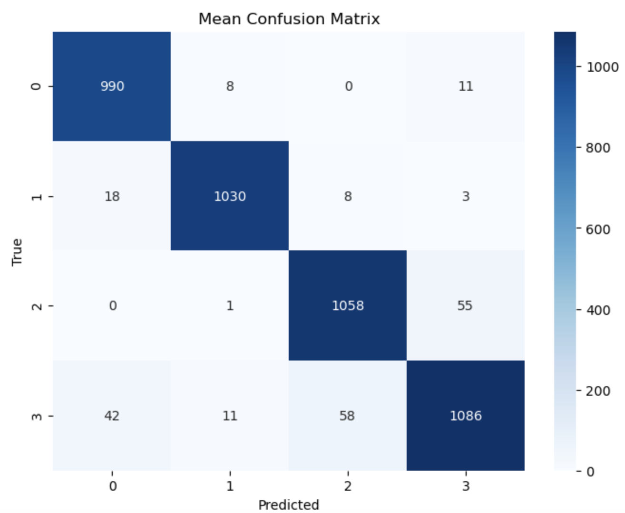
Process
Modeling
Feed-Forward Neural Network
Neural Network Modeling Results
Dataset Balancing
Missing Value Imputation
Preferred Model Configuration Confusion Matrix
Results
While imputation by class label seems ideal, the process utilized introduced error.
The resampled dataset utilizing whole dataset imputation, validated using StratifiedKFold 10-fold cross validation resulted in the most accurate predictions.
Model Configuration
10-Fold
Cross Validation

Slide 12
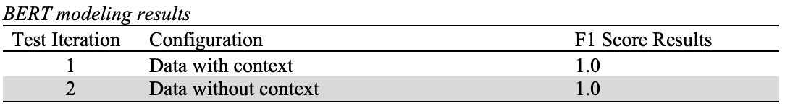
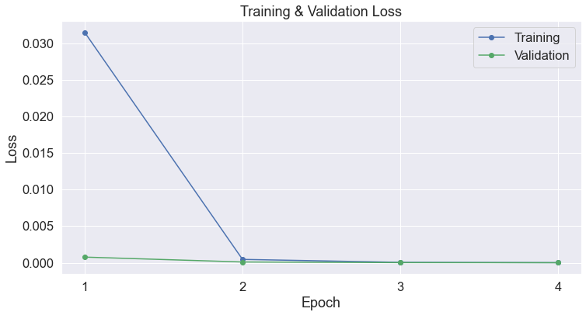
Process
Modeling
BERT
Label Resampling
Bert Modeling Results
Data Concatenation
Bert Modeling Training & Validation Loss
Results
Although the training and validation loss curves converge nicely, such extremely high accuracy and F1 scores suggest overfitting and the inability for the model to generalize.
Further research is necessary to determine the cause of these results.
Embeddings
Hyper-parameter Tuning
Evaluation
Notes:
Training process:
Label resampling
Data concatenation
Embeddings
Hyperparameter tuning
Evaluation

Slide 13
Modeling
Feature Importance
Feed-Forward Neural Network
XGBoost

Slide 14
Modeling
Comparison
Model Performance by F1 Scores
FNN
XGBoost / Random Forest
BERT

Slide 15
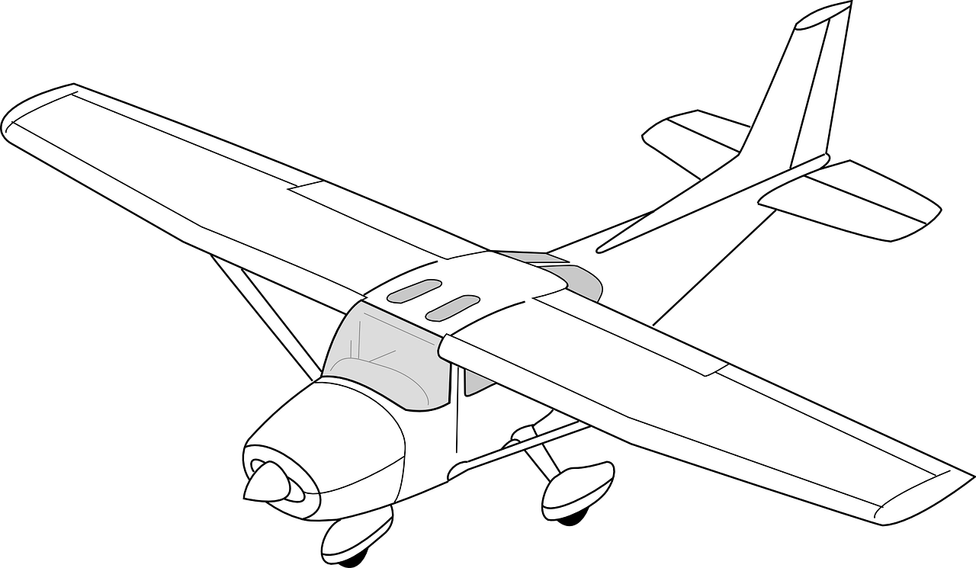
Future Work
Way Forward
1 |
Further development, testing, and evaluation of methods and high performing models, along with the incorporation of improved missing value imputation methodology for neural networks.
2 |
Expansion of training dataset to include low risk flight records based on voluntary general aviation pilot participation. Reduces bias in model by reducing need for rebalancing.
Deploy the optimal model through development of an application for the ingestion of new flight records, incorporating risk assessment class assignment (see next slide).
3 |
Notes:
Kathleen

Slide 16
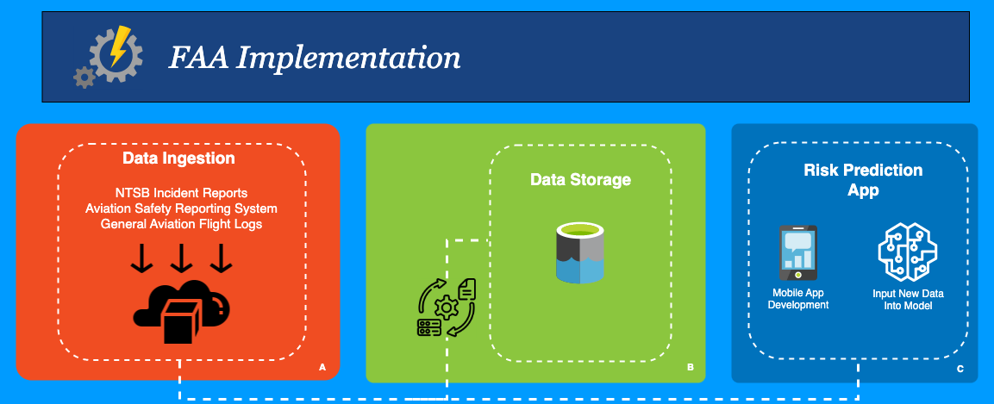
Next Steps
The Way Forward

Slide 17

Questions

Slide 18
References
Boyd, D. D. (2017). A Review of General Aviation Safety (1984–2017). Aerospace Medicine and Human Performance, 88(7), 657–664. https://doi.org/10.3357/amhp.4862.2017
Flaticon. (2023a, May 30). Airplane Icon - 561698. https://www.flaticon.com/free-icons/airport
Flaticon. (2023b, May 30). Data modelling Icon - 8329485. https://www.flaticon.com/free-icons/predictive-modeling
Flaticon. (2023c, May 30). Digital Transformation Icon - 9768191. https://www.flaticon.com/free-icons/digital-transformation
Flaticon. (2023d, May 30). Etl Icon - 5708950. https://www.flaticon.com/free-icons/etl
Flaticon. (2023e, May 30). Evaluation Icon - 6757112. https://www.flaticon.com/free-icons/risk-management
Flaticon. (2023f, May 30). Plane Icon - 723955. https://www.flaticon.com/free-icons/plane
Fultz, A. J., & Ashley, W. S. (2016). Fatal weather-related general aviation accidents in the United States. Physical Geography, 37(5), 291–312. https://doi.org/10.1080/ 02723646.2016.1211854
National Business Aviation Association. (n.d.). Flight Risk Assessment Tool. https://nbaa.org/wp-content/uploads/2018/06/flight-risk-assessment-tool.pdf
Resources - Library Contents - FAA - FAASTeam - FAASafety.gov. (n.d.). https://www.faasafety.gov/gslac/ALC/libview_normal.aspx?id=352396
Wright, R. (2019, October 29). Risk assessment tools. Aviation Safety. Retrieved January 11, 2023, from https://www.aviationsafetymagazine.com/features/risk-assessment-tools/
ZDigitalPro,LLC. (2017, April 18). ‎Flight Risk Assessment Tool. https://apps.apple.com/us/app/flight-risk-assessment-tool/id1080401103?platform=iphone

Slide 19
Methodology
Data
Collection
Data
Transformation
Modeling

Slide 20
Methodology
Data
Collection
Data
Transformation
Data
Labeling
Modeling
NTSB Incident Records
Filter
Join
Format
Test Prep
Risk Category Assignment
Preparation
Execution
Evaluation

